Slide 1
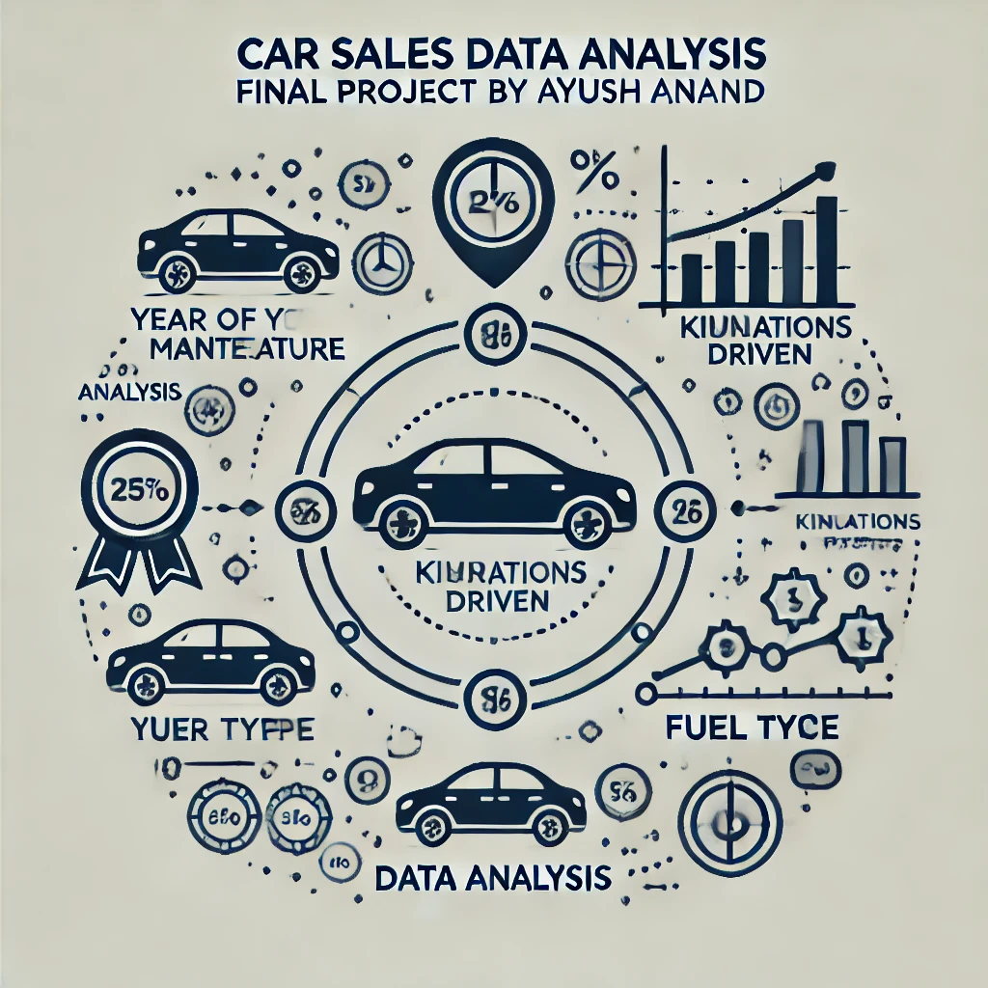

Car Sales Data Analysis - Final Project ALY 6010: Probability Theory and Introductory Statistics
Module 6- Final Project

Slide 2
Table of Content
About the Dataset
Questions to Answer from this Dataset
Descriptive Statistics
Framing Hypotheses
Correlation Analysis
Regression Analysis
MRSE Calculation
Assessing Model Fit
Report Summary
References

Slide 3
About the Dataset
This report provides a comprehensive analysis of car sales data, with a focus on understanding the relationships between selling price and various factors such as the manufacturing year, kilometers driven, and fuel type. Linear regression and hypothesis testing were employed to investigate these relationships, with a final evaluation of model accuracy and robustness through error metrics and cross-validation.
Variable | Description
name | The model name of the car (character)
year | The year of manufacture (integer)
selling_price | Selling price of the car in Indian Rupees (₹) (integer)
km_driven | Kilometers driven by the car (integer)
fuel | Fuel type of the car (Petrol or Diesel) (character)
seller_type | Type of seller, e.g., Individual or Dealer (character)
transmission | Transmission type of the car (e.g., Manual or Automatic) (character)
owner | Ownership status (e.g., First Owner, Second Owner) (character)
The dataset contains 3962 observations and 8 variables described below:

Slide 4
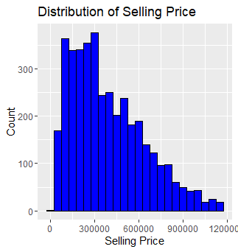
Exploratory Data Analysis (EDA)
A histogram was plotted to understand the spread and frequency of car prices.
The plot uses a bin width of 50,000 units to group car prices into intervals. The bars are filled in blue with black borders.
Purpose: This histogram helps to understand the distribution of car prices, identify common price points, and highlight any outliers.
Key Insights: Selling Price Distribution: Most cars fall within a price range of ₹200,000 to ₹550,000.

Slide 5
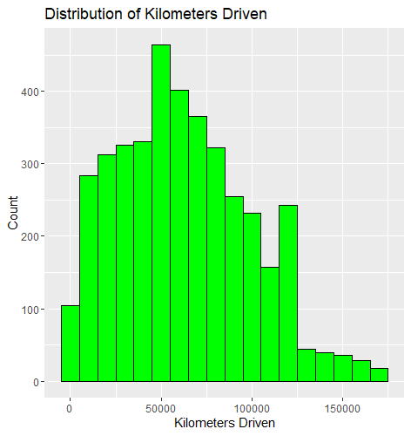
A histogram was used to visualize the distribution of kilometers driven
The plot uses a bin width of 10,000 units, with bars filled in green and bordered in black.
Purpose: This histogram helps to identify the most common mileage ranges and potential outliers in the dataset.
Key Insights:
Kilometers Driven Distribution: Majority of cars have mileage below 100,000 km.

Slide 6
Key Questions Explored
Does the year of manufacture significantly affect the car's selling price?
Why This Question? Year of manufacture often plays a key role in determining car value, as newer models tend to have updated features and improved reliability. It is important to understand whether the age of the car is a strong determinant of its price.
Does the number of kilometers driven significantly impact the car's selling price?
Why This Question? Kilometers driven is an indicator of how much a car has been used. High mileage often leads to lower value due to wear and tear. Understanding the effect of mileage helps in assessing how usage impacts car pricing.
Does the fuel type (Diesel vs. Petrol) significantly affect the selling price of cars?
Why This Question? Initial observations indicated a price difference between Diesel and Petrol cars. Diesel cars are often considered more fuel-efficient, which could make them more attractive to buyers. Analyzing the effect of fuel type helps understand buyer preferences and market trends.

Slide 7
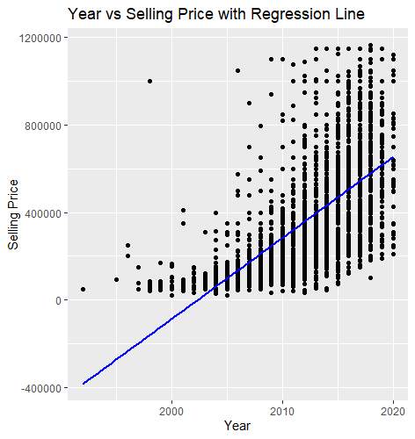
Hypothesis testing and Regression Analysis 1. Regression Analysis of Year vs. Selling Price
Interpretation:
The positive year coefficient (37,040) suggests that each additional year increases the selling price by an average of ₹37,040.
An R-squared value of 0.3971 indicates that approximately 39.71% of the variability in selling price is explained by the year of manufacture.
Hypothesis Test
Null Hypothesis (H₀): β₁ ≤ 0 (The year of manufacture does not have a significant positive impact on the selling price, or has no impact or a negative impact.)
Alternative Hypothesis (H₁): β₁ > 0 (The year of manufacture has a significant positive impact on the selling price.)
Result: With a p-value below 0.05, we reject the null hypothesis, confirming that there is a statistically significant positive impact of the year of manufacture on the selling price

Slide 8
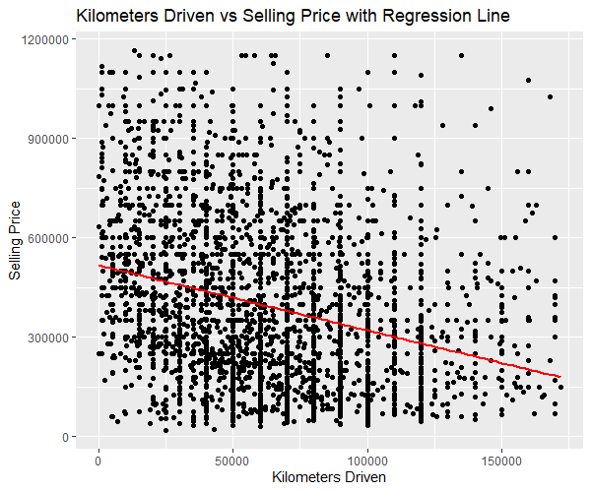
2. Regression Analysis of Kilometers Driven vs. Selling Price
Interpretation:
The negative coefficient (-1.962) suggests that for every additional kilometer driven, the selling price decreases on average by ₹1.96.
An R-squared value of 0.08176 suggests that only 8.18% of the variability in selling price is explained by kilometers driven.
Hypothesis Test
Null Hypothesis (H₀): β₁ ≥ 0 (The kilometers driven does not have a significant negative impact on the selling price, or has no impact or a positive impact.)
Alternative Hypothesis (H₁): β₁ < 0 (The kilometers driven has a significant negative impact on the selling price.)
Result: With a p-value below 0.05, we reject the null hypothesis, indicating a statistically significant negative impact of kilometers driven on the selling price.

Slide 9
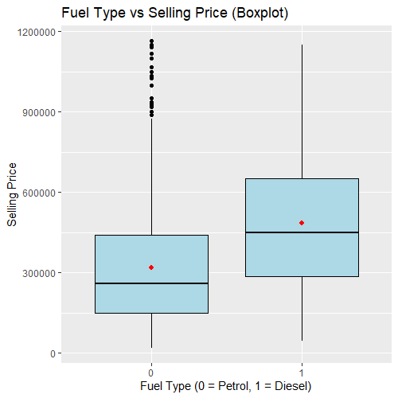
3. Fuel Type Comparison: Diesel vs. Petrol Cars
Interpretation:
The Fuel Binary Coefficient of 167,900 indicates that Diesel cars are predicted to sell for an average of ₹167,900 more than Petrol cars.
Null Hypothesis (H₀): μ₁ ≤ μ₂ (The mean selling price of Diesel cars (μ₁) is less than or equal to the mean selling price of Petrol cars (μ₂), indicating no significant difference or Diesel being lower.)
Alternative Hypothesis (H₁): μ₁ > μ₂ (The mean selling price of Diesel cars (μ₁) is significantly greater than the mean selling price of Petrol cars (μ₂).)

Slide 10
Model Performance Evaluation
Root Mean Squared Error (RMSE): 238,834.9
RMSE measures the average deviation between predicted and actual selling prices.
Interpretation: A lower RMSE indicates better model accuracy.
Cross-Validation
To validate model stability, a 10-fold cross-validation was performed on a simplified model, yielding:
Cross-Validation Error: 54,649,936,551
This error indicates the model's prediction variance across different subsets of the data, assessing its robustness.

Slide 11
Predicted vs. Actual Prices
A comparison of actual vs. predicted values from the test set reveals how closely the model predictions align with the real selling prices:
Actual Price (₹) | Predicted Price (₹)
600,000 | 482,837.2
140,000 | 314,937.2
600,000 | 482,837.2
250,000 | 314,937.2
750,000 | 482,837.2
160,000 | 314,937.2
This comparison illustrates the model’s prediction accuracy, highlighting areas for potential improvement.

Slide 12
Conclusion
This analysis explores car sales data to identify the factors influencing car selling prices. The dataset includes 3,962 car records with 8 features, such as year of manufacture, kilometers driven, and fuel type. Through regression analysis and hypothesis testing, it was found that newer cars, lower mileage, and Diesel fuel type significantly increase selling prices. Regression models indicate that year and fuel type are positively correlated with selling price, while higher kilometers driven negatively impacts value. Model accuracy, evaluated through RMSE and cross-validation, suggests reasonable prediction performance, with opportunities for improvement in predicting complex interactions. The analysis provides actionable insights for car dealers, such as focusing on newer Diesel vehicles for maximizing profit. Future analyses could incorporate additional attributes, such as car brand, model, and condition, to improve predictive power and better understand the determinants of car pricing.

Slide 13
References Vehicle Dataset from CarDekho [Data set]. Retrieved [Date Retrieved] from Kaggle. https://www.kaggle.com/datasets/nehalbirla/vehicle-dataset-from-cardekho Motorcycle Dataset [Data set]. Retrieved [Date Retrieved] from Kaggle. https://www.kaggle.com/datasets/nehalbirla/motorcycle-dataset Kutner, M. H., Nachtsheim, C. J., Neter, J., & Li, W. (2004). Applied Linear Statistical Models (5th ed.). McGraw-Hill Irwin.

Slide 14
Thank you!

